Slide 1


JARVIS
Your personal voice assistant
Team :peculiar sloth
Team member :
Noushin Anjum Raya(231_134_005)
Syed Tanjim Ahmed(231-134-002)
Rafid Hasan Sidney(222-134-009)

Slide 2

Outline
Introduction
Objective
Methodology
Code Structure
Use of JARVIS
Future work
Conclusion

Slide 3
INTRODUCTION
Meet Jarvis, your Python-powered voice assistant! With email sending, news updates, weather info, and a touch of humor, Jarvis simplifies your digital life. Need a quick web search, the time, or a joke? Jarvis has you covered. Stay organized, flip a coin, or generate a password on the fly. Just say "Jarvis," and let the magic happen. Welcome to a world where technology meets assistance.

Slide 4
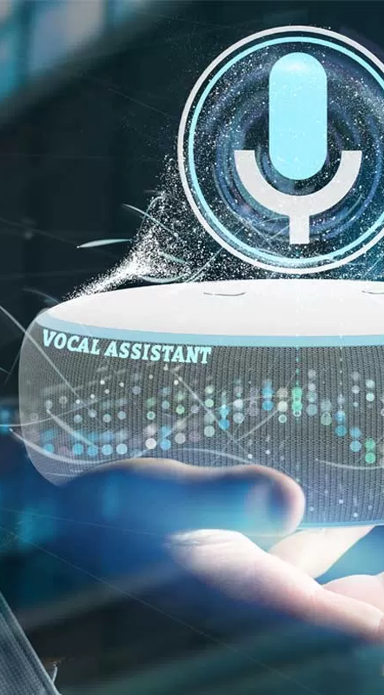
OBJECTIVES
The code aims to create a voice controlled virtual assistant , Jarvis, capable of performing various tasks based on user voice commands . It provides functionalities such as time reporting, email sending , google searching, weather information retrieval, news updates , and more , making it a versatile assistant for daily use.

Slide 5



METHODOLOGY
Initialization:
Set up the TTS engine, initialize voices, and create a contacts dictionary.
Command Processing:
Identify user intent by analyzing commands, triggered by the wake word "jarvis.“
Voice Recognition:
use the speech Recognition library to continuously listen for voice commands.

Slide 6
METHODOLOGY
Voice Switching:
Allow users to switch between male (Jarvis) and female (Friday) voices.
Data Persistence:
Store contacts and email information in JSON files.
User Interaction:
Interact with the user through TTS for spoken responses and accept
voice or text commands.

Slide 7
METHODOLOGY
Termination:
Continue running until the user issues the "offline" command.
Functionalities:
Provide time, CPU, and battery status.
- Capture and display the last screenshot.
- Manage contacts and send emails.
Functionalities(1):
- Perform Google searches and fetch weather information.
- Retrieve and read news headlines.

Slide 8
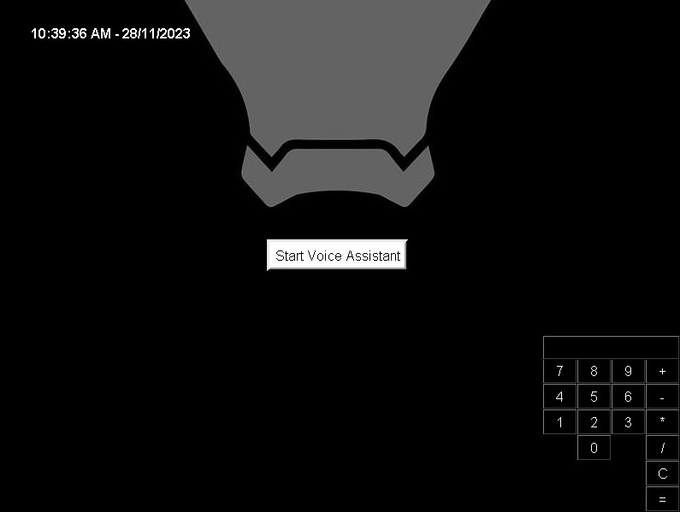
Voice Assistant UI

Slide 9
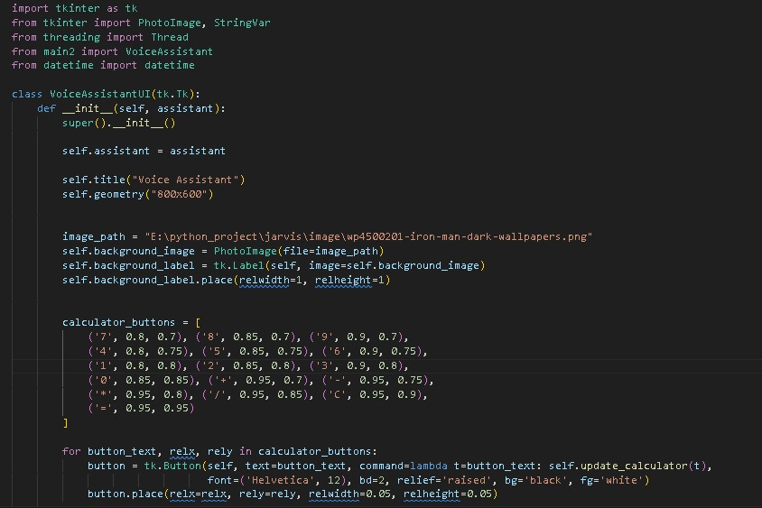
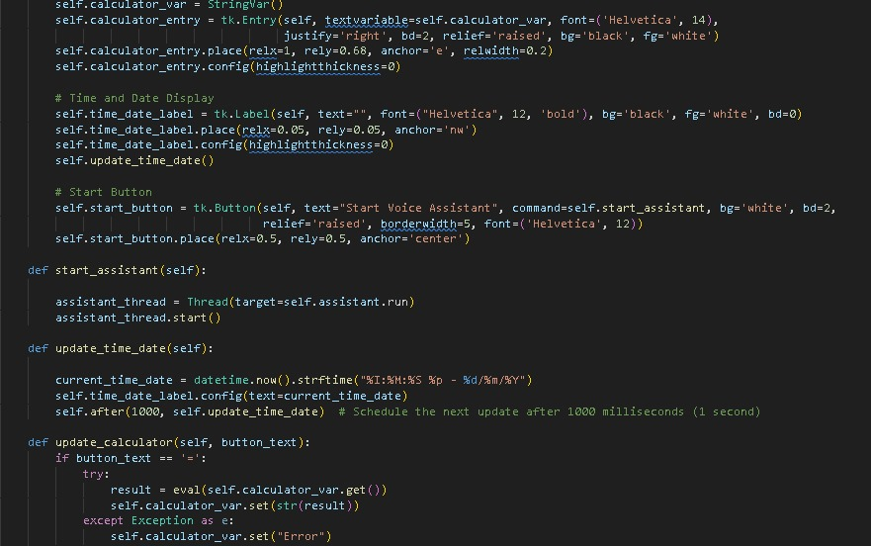
Code Structure

Slide 10
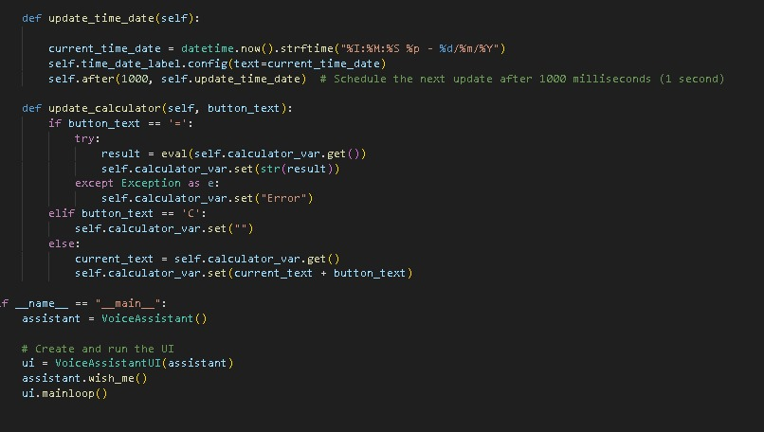
Code Structure

Slide 11
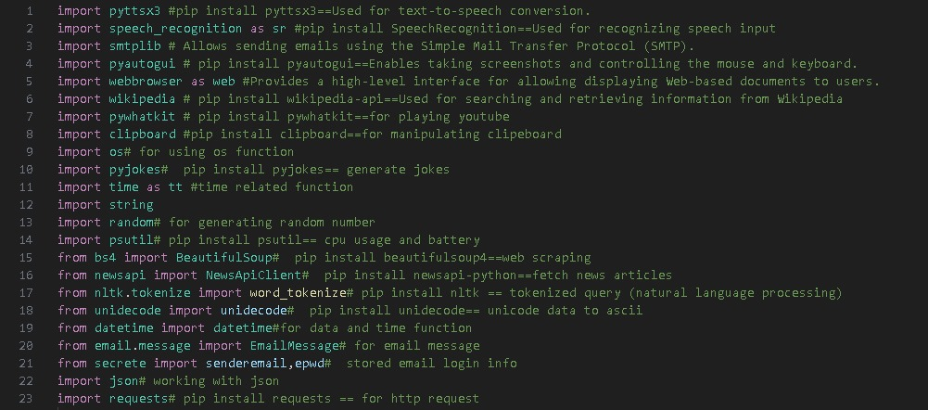
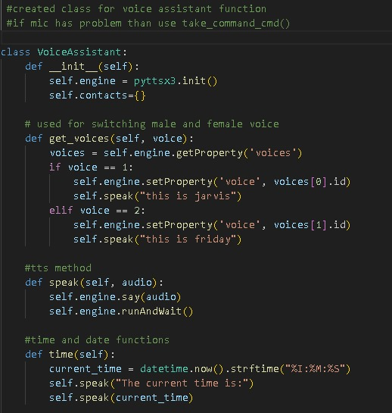
Code Structure
Main2.py

Slide 12
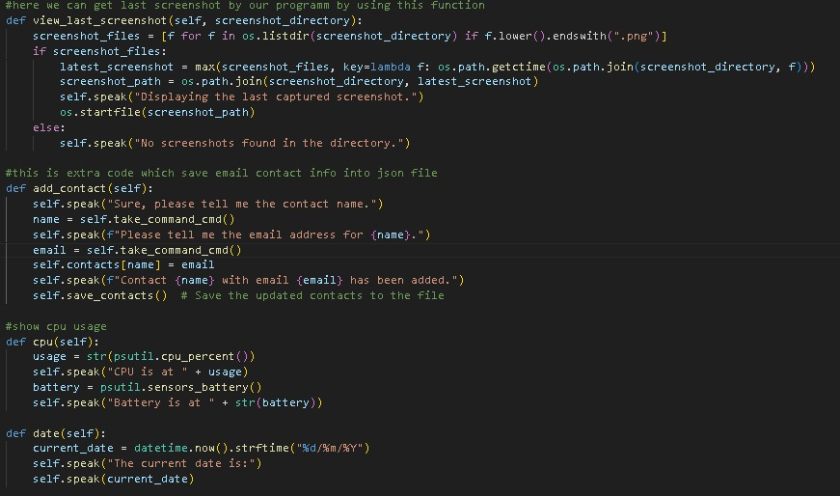
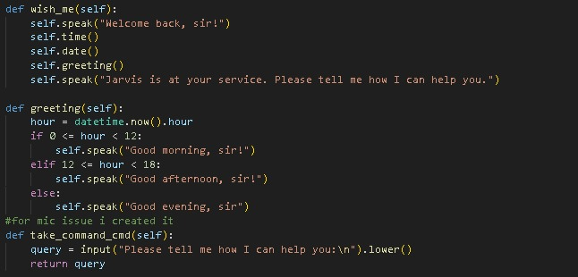
Code Structure

Slide 13
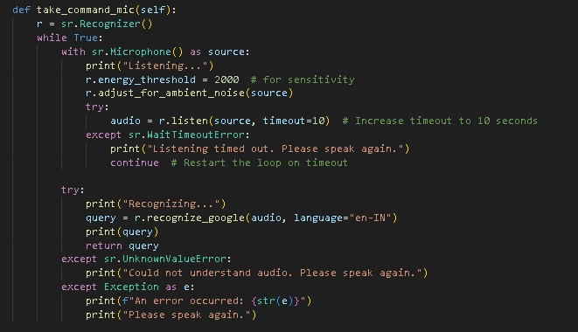
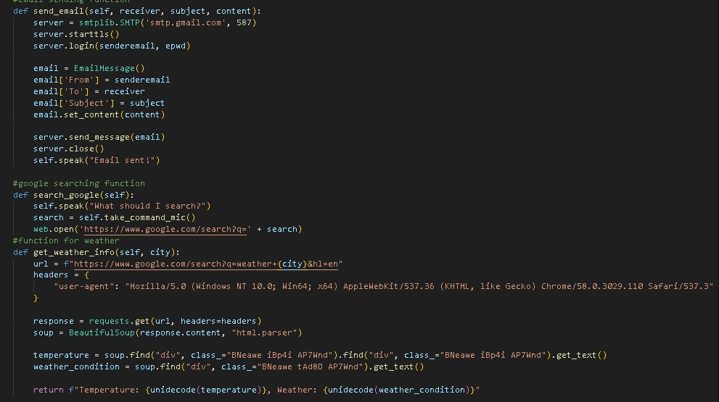
Code Structure

Slide 14
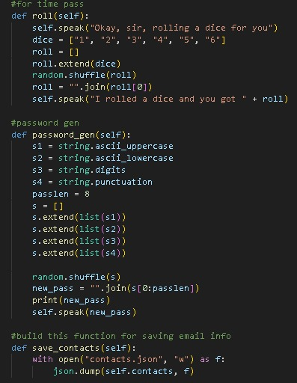
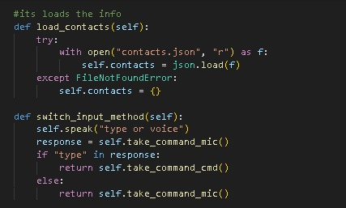
Code Structure

Slide 15
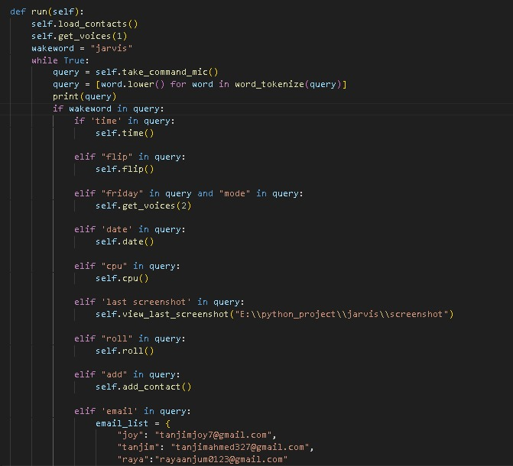
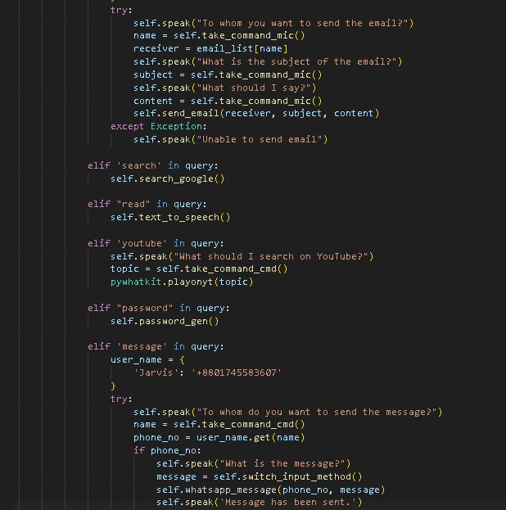
Code Structure

Slide 16
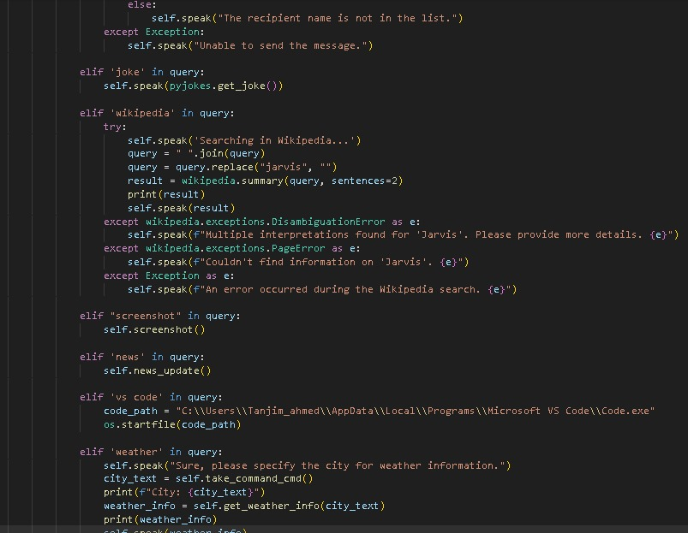
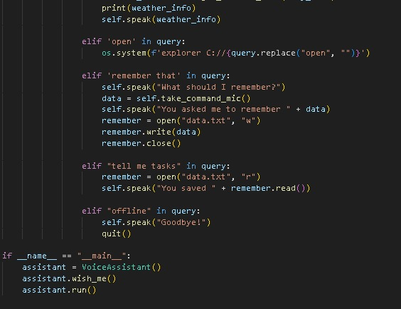
Code Structure

Slide 17

1.Send email
2.Take screenshot
3.Save contacts
4.Generate password.
5.Searching on Wikipedia.
6.Searching on Google.
7.Can remember tasks
8.Searching on You tube.
9.Female mode.
10.Can tell jokes.
11.It can roll dice and flip coin(head or tail).
12.Send messages on What’s app.
13.Open VS code.
14.Weather information.
15.Date and time information.
16.Can read news.
17.CPU usage.
Use
Of JARVIS

Slide 18
Social Media Integration
Allow voice commands for social media actions.
Enchanced Language Understanding
Integrate Natural Language processing (NLP) for improved comprehension of complex commands.
FUTURE
WORK
Predictive Functionality
Utilize machine learning to predict user actions based on historical patterns.
Continuous Learning
Establish a feedback loop for ongoing improvement.

Slide 19
Conclusion
The voice Assistant provides a seamless and interactive experiences , catering to a variety of user needs . It combines practical functionalities with entertainment features , making it a well – rounded tool.
The modular design allows for easy expansion and customization in the future

Slide 20

THANK YOU
For stay with us!

